Slide 1



Call Center Customer Satisfaction Data by Kamal Kumar
View in Power BI
Last data refresh:
11/9/2021 6:01:18 AM UTC
Downloaded at:
11/9/2021 6:02:08 AM UTC

Slide 2
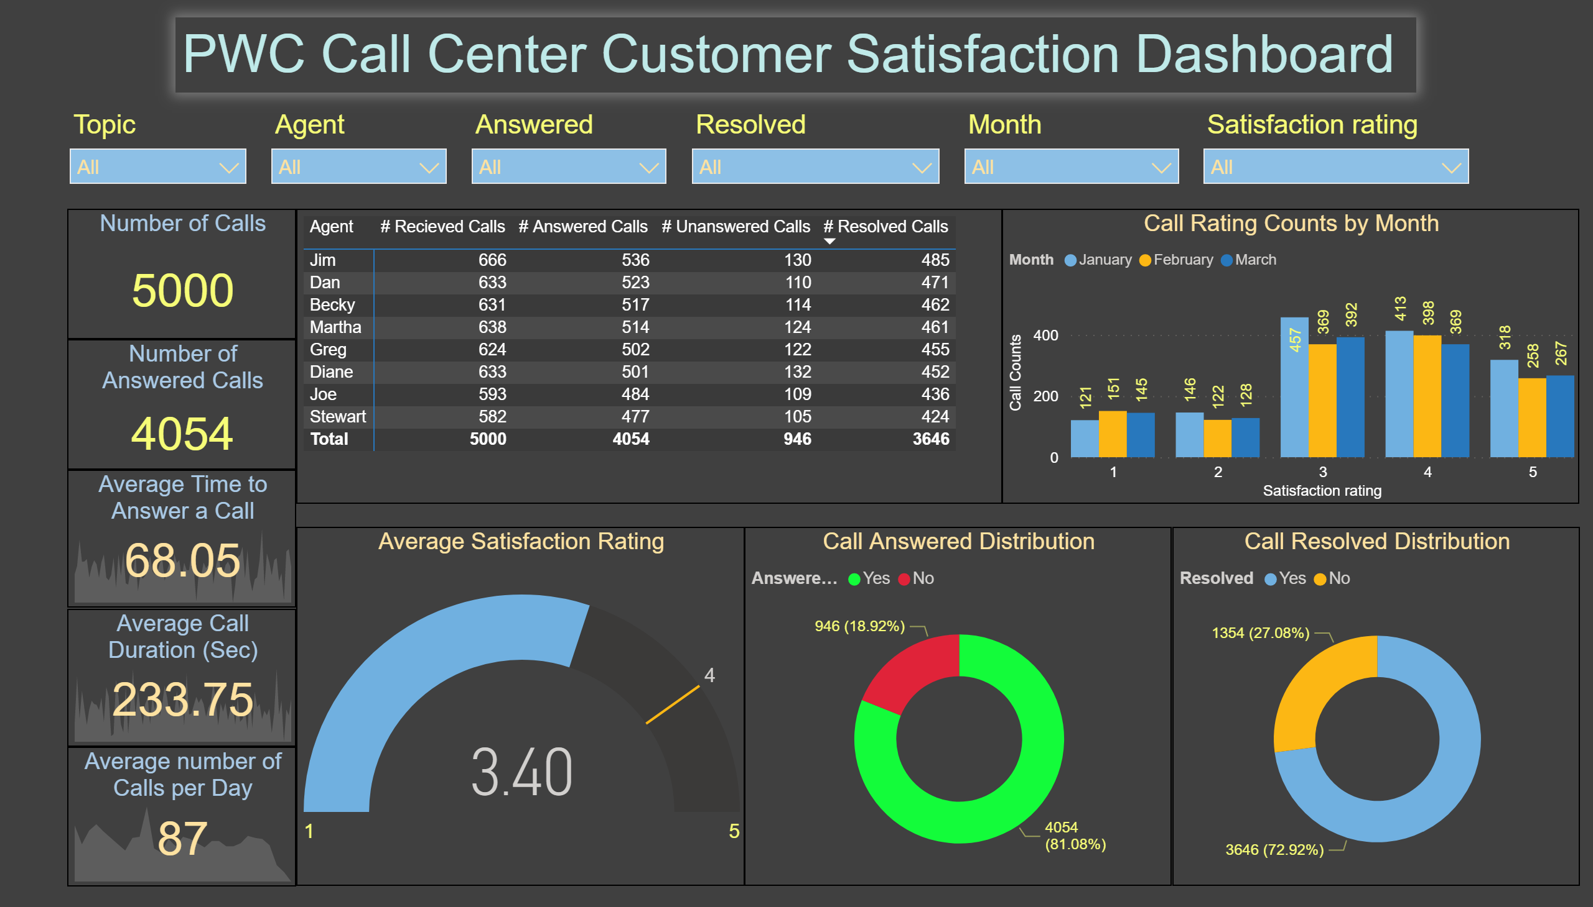
Page 1
Notes:
textbox
No alt text provided.
slicer
No alt text provided.
slicer
No alt text provided.
slicer
No alt text provided.
slicer
No alt text provided.
Average Satisfaction Rating
No alt text provided.
Distribution of Calls by Agent
No alt text provided.
Call Rating Counts by Month
No alt text provided.
Call Answered Distribution
No alt text provided.
Call Resolved Distribution
No alt text provided.
Average Time to Answer a Call
No alt text provided.
Average number of Calls per Day
No alt text provided.
Average Call Duration (Sec)
No alt text provided.
Number of Calls
No alt text provided.
Number of Answered Calls
No alt text provided.
slicer
No alt text provided.
slicer
No alt text provided.

